Slide 1
Lecture-11
Government of Bangladesh

Slide 2
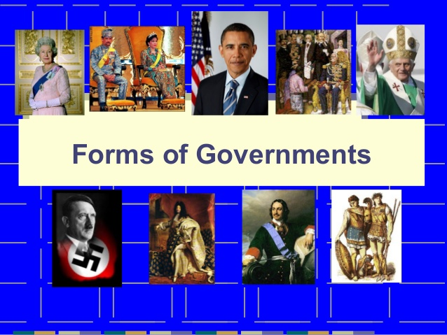

Slide 3
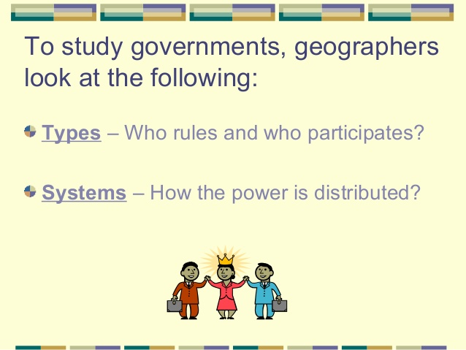

Slide 4
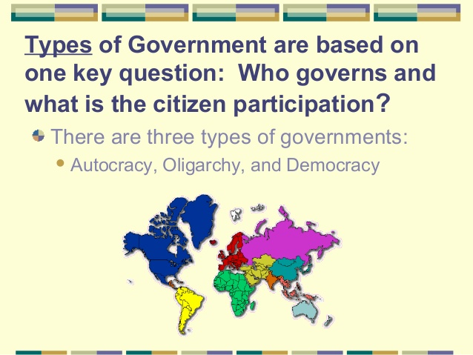

Slide 5
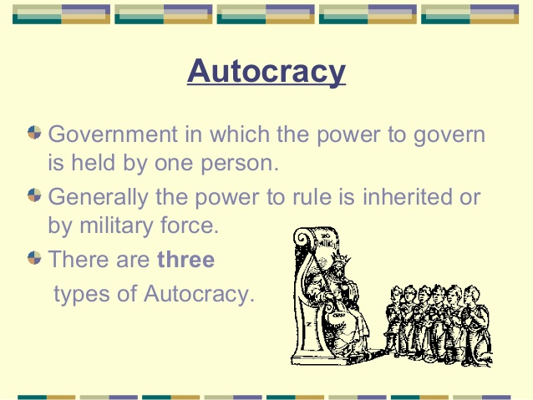

Slide 6
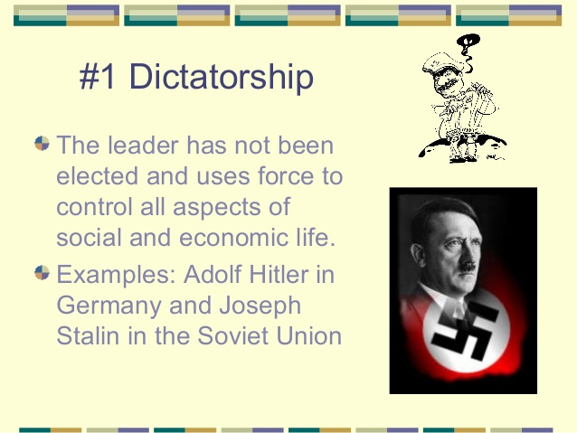

Slide 7
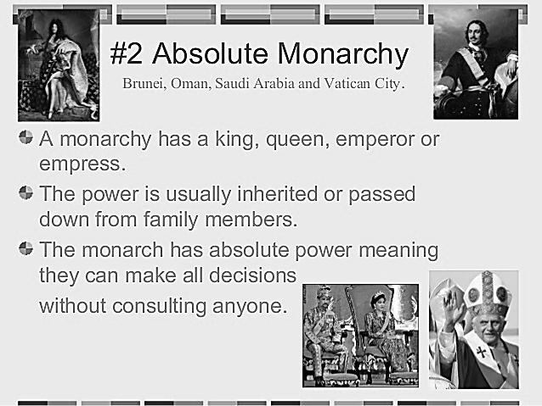

Slide 8
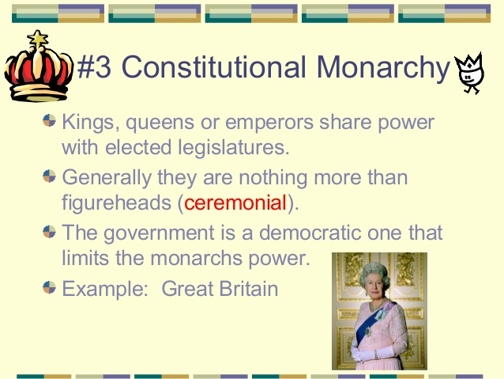

Slide 9
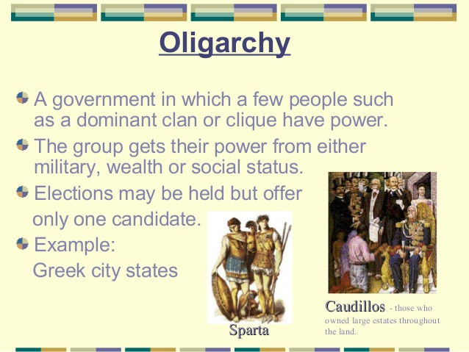

Slide 10
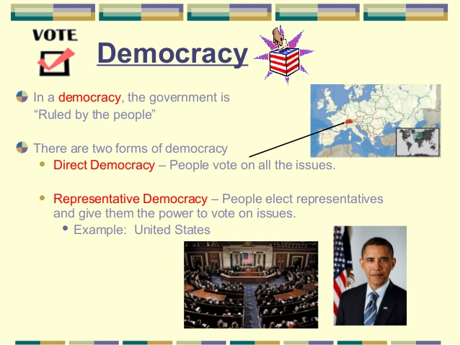

Slide 11
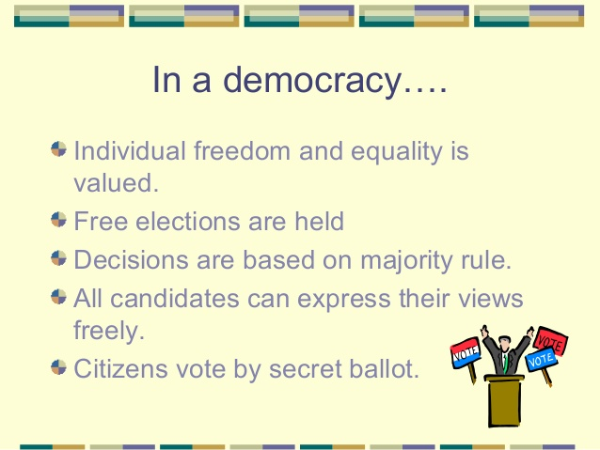

Slide 12
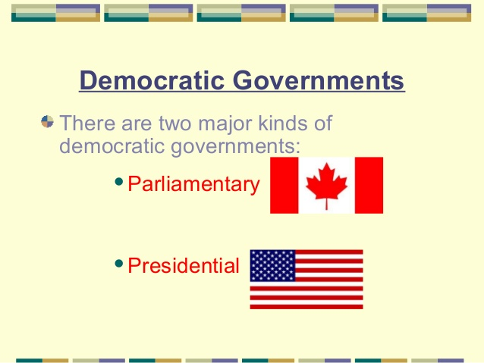

Slide 13
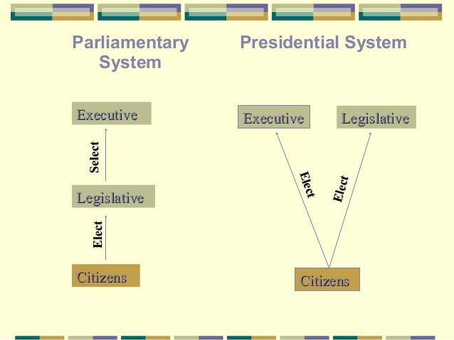

Slide 14
Republic
Rule by a form of government in which the people, or some significant portion of them, have supreme control over the government and where offices of state are elected or chosen by elected people.
Constitutional republic: Rule by a government whose powers are limited by law or a formal constitution, and chosen by a vote amongst at least some sections of the populace.
Examples: The United States, South Africa, India, etc.
Parliamentary republic: A republic, like India, Singapore and Poland, with an elected head of state, but where the head of state and head of government are kept separate with the head of government retaining most executive powers, or a head of state akin to a head of government, elected by a parliament.

Slide 15
Federal republic: A federal union of states or provinces with a republican form of government. Examples: Argentina, Austria, Brazil, Germany, India, Russia, and Switzerland
Islamic Republic: Republics governed in accordance with Islamic law. Examples: include Afghanistan, Pakistan, and Iran.
Socialist Republic: Countries like China and Vietnam are meant to be governed for and by the people, but with no direct elections. The term People's Republic is used to differentiate themselves from the earlier republic of their countries before the people's revolution, like the Republic of China and Republic of Korea.

Slide 16
Other types of govt system
Anarchy
Anarchy is a situation where there is no government. This can happen after a civil war in a country, when a government has been destroyed and rival groups are fighting to take its place.
Anarchists are people who believe that government is a bad thing in that it stops people organizing their own lives.
Example: Afghanistan
Capitalist
In a capitalist or free-market country, people can own their own businesses and property. People can also buy services for private use, such as- healthcare.
But most capitalist governments also provide their own education, health and welfare services.
Communist
In a communist country, the government owns property such as businesses and farms.
It provides its people's healthcare, education and welfare.

Slide 17
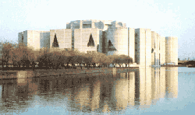
Government of Bangladesh
The Government of Bangladesh (Bengali: বাংলাদেশ সরকার Bangladesh Sôrkar GOB) is led by the Prime Minister, who selects all the remaining Ministers. The Prime Minister and the other most senior Ministers belong to the supreme decision-making committee, known as the Cabinet. The Government has three branches; the Executive branch, the Legislative branch and the Judicial branch.

Slide 18

Government system of Bangladesh
The Constitution of the People’s Republic of Bangladesh is the constitutional document of Bangladesh. It was adopted on 16 December 1972. It provides the framework of the Bangladeshi republic with a parliamentary government, fundamental human rights and freedoms, an independent judiciary, democratic local government and a national bureaucracy. The constitution includes references to socialism, Islam, secular democracy and the Bengali language. It commits Bangladesh to “contribute to international peace and co-operation in keeping with the progressive aspirations of mankind”.

Slide 19
Main office holders
Office | Name | Party | Since
President of Bangladesh | Abdul Hamid | Awami League | 24 March 2013
Prime Minister of Bangladesh | Sheikh Hasina Wazed | Awami League | 6 January 2009
Speaker of the Parliament | Shirin Sharmin Chaudhuy | Awami League | 30 April 2013
Chief Justice of Bangladesh | Syed Mahmud Hossain | Nonpartisan | 2 February2018

Slide 20
Head of State
The President is the Head of State, a largely ceremonial post.
The real power is held by the Prime Minister, who is the head of government.
The president is elected by the legislature every five years.
As head of the state, the president can grant pardon to a man sentenced to death penalty or lessen the punishment.
In some cases, it also performs some legislative and judicial functions.

Slide 21
Organ of the Government
The Government has three branches;
the Executive branch,
the Legislative branch
the Judicial branch.

Slide 22
1. Executive branch
Prime Minister
The prime minister is ceremonially appointed by the president, commanding the confidence of the majority of the MPs. The cabinet is composed of ministers selected by the prime minister and appointed by the president.
Cabinet
The executive administrates the country and executes the laws, passed by the legislature. It maintains the internal law and order in the country. It also maintains relationship with foreign countries. It works for defence, liberty and sovereignty of the country.
Agencies
The executive calculated the income and expenditure of the government. It also performs various public welfare services such as; education, agriculture, establishment of industry, trade & commerce, land reform, tax and revenue collection. Beside this, it also accepts and implements various development projects.

Slide 23
2. Legislative branch
The legislature of Bangladesh is unicameral.
The 300 members are elected by universal suffrage at least every 5 years.
It consists of 350 members at present. There is universal suffrage for all citizens at the age of 18.
"On 16 May 2004, the Jatiyo Sangsad (the National Parliament) passed the 14th constitutional amendment to reintroduce quotas for women (article 65)
The 10th Parliament had its first sitting on 25 January 2009 . Currently there are 350 members of the house of which 50 memberships are reserved for women.

Slide 24
3. Judicial branch
Supreme Court
The highest judiciary body is the Supreme Court. Until recently, Chief Justice and judges were recommended by the Prime Minister and formally appointed by the President.
The Supreme Court have now judiciary and administrative authority over all lower courts in the country.
District Courts
Specialized Courts and Tribunals

Slide 25
Local Government
At the local government level, the country is divided into divisions, districts, subdistricts (Upazila), unions, and villages.
The lowest level of local government representative are Local officials of union council those who are elected at the union level election.
All larger administrative units are run by members of the civil service.

